Slide 1
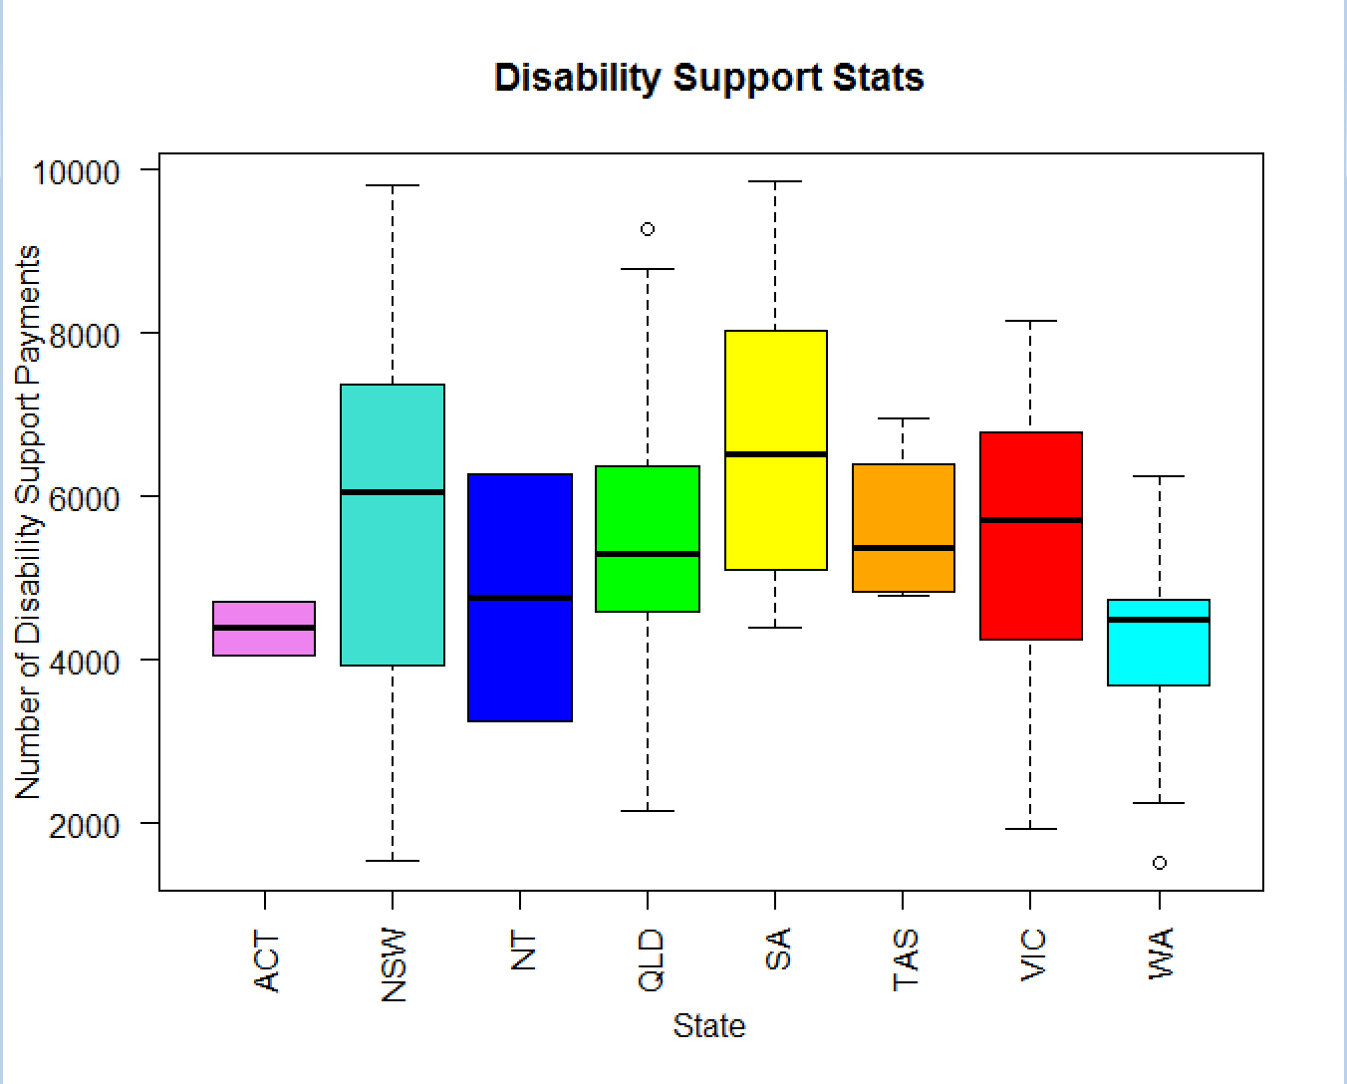
Ready for Box Plots!
John Tukey - 1977

Slide 2
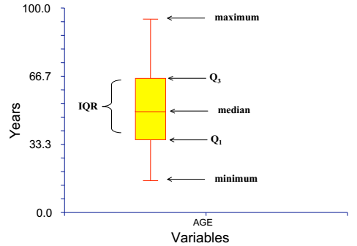
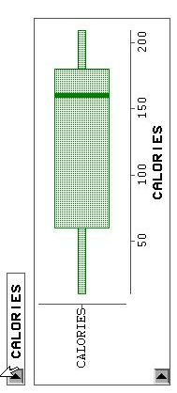
Box Plot for Calories
A visualization of most of the basic statistics.

Slide 3
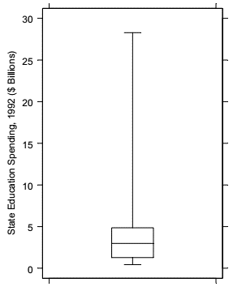
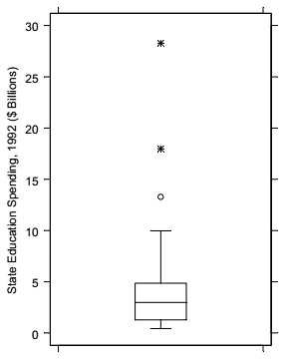
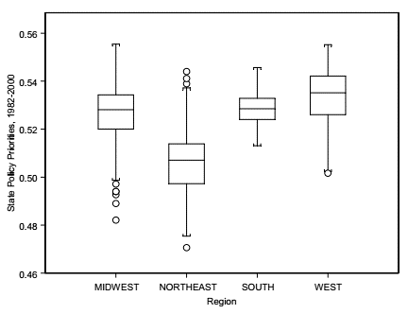
Box Plot and Outliers

Slide 4
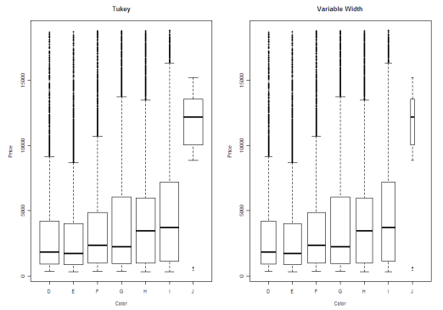
Examples
From the first plot it appears that the overall median price might be between 5,000 and 10,000. However, the actual overall median price is 2,374.
Looking at the variable width boxplot in the middle of figure four it is obvious that J has far fewer observations than the other groups.

Slide 5
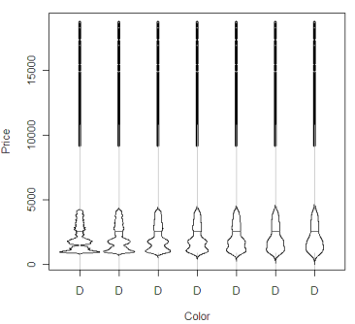
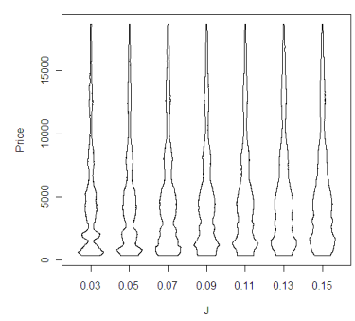
Examples
VasePlot: The width of the box at each point is
proportional to the estimated density
Violin Plot: use all the data to plot a density curve. The amount of smoothing to use is at the discretion of the analyst.

Slide 6
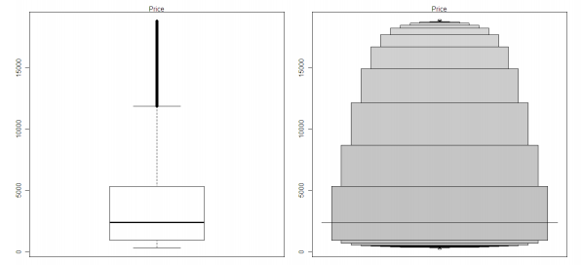
Hofmann, Kafadar, and Wickham, 2006
Letter-value Boxplot:
To accommodate large datasets. For moderate sized datasets (n < 1,000), estimates about the behavior in the tails are not reliable. Large datasets (n = 10,000 100,000) yield much more reliable estimates about the behavior beyond the quartiles. The simple boxplot is not a good method for large datasets, since there is often too much over-plotting in the outlier region.
1-1/16
0.9375
1-1/8
0.875
1-1/4
0.75
1-1/2
0.5
Letter-value boxplots of color vs. price display the data past the quartiles in a more meaningful manner than does the original boxplot.

Slide 7
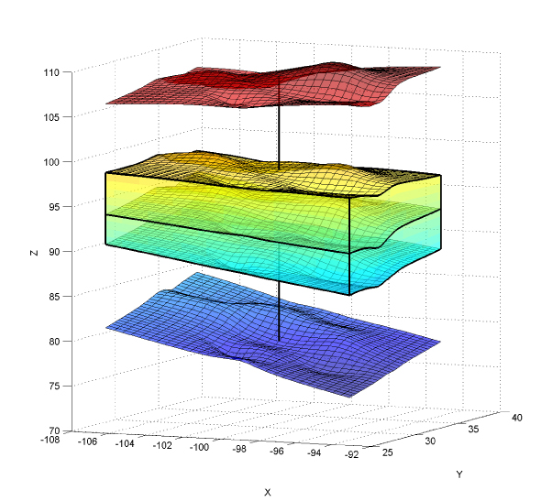
Surface Box Plot
The surface boxplot with the box in the middle representing the 50% central region in R3, the middle surface inside the box denoting the median surface, and the upper and lower surfaces indicating the maximum non-outlying envelope.

Slide 8
Normalization and Standardization
Normalization of data is to rescale the data to have values between 0 and 1. This can be done by subtracting the minimum data value from each data point and then dividing the subtracted value by the range of the data.
X_{new} = (X_{old} - X_{min}) / (X_{max} - X_{min})
Standardization of data is to rescale the data to have mean 0 and standard deviation 1. This can be done by subtracting the mean M from each data point and then dividing the subtracted value by the standard deviation S.
X_{new} = (X_{old} - M) / S

Slide 9
Normalization and Standardization
Normalization of data is to rescale the data to have values between 0 and 1. This can be done by subtracting the minimum data value from each data point and then dividing the subtracted value by the range of the data.
X_{new} = (X_{old} - X_{min}) / (X_{max} - X_{min})
Standardization of data is to rescale the data to have mean 0 and standard deviation 1. This can be done by subtracting the mean M from each data point and then dividing the subtracted value by the standard deviation S.
X_{new} = (X_{old} - M) / S
Class Activity
Let H1, H2, H3 be the histograms of a set X of positive numbers.
What are the visual differences between H1 and H2?
What are the visual differences between H2 and H3?
What is the benefit of normalization and Standardization?

Slide 10
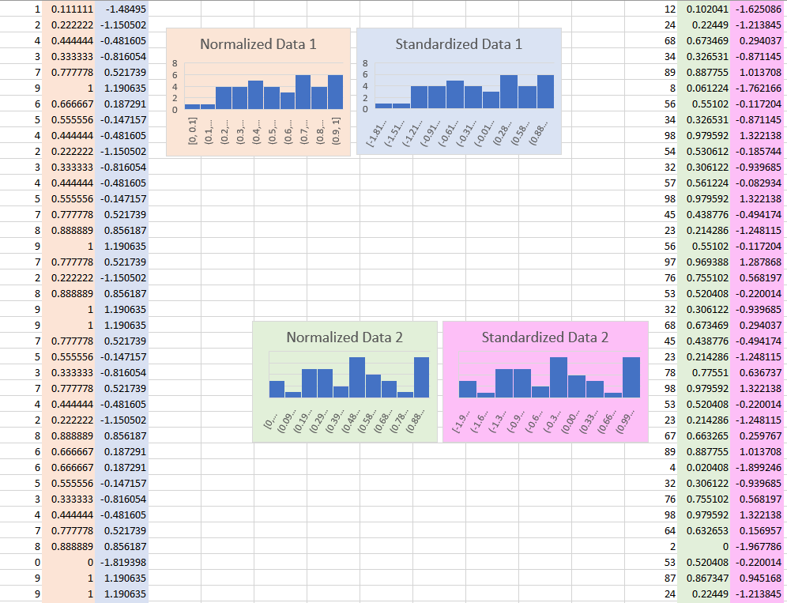

Slide 11

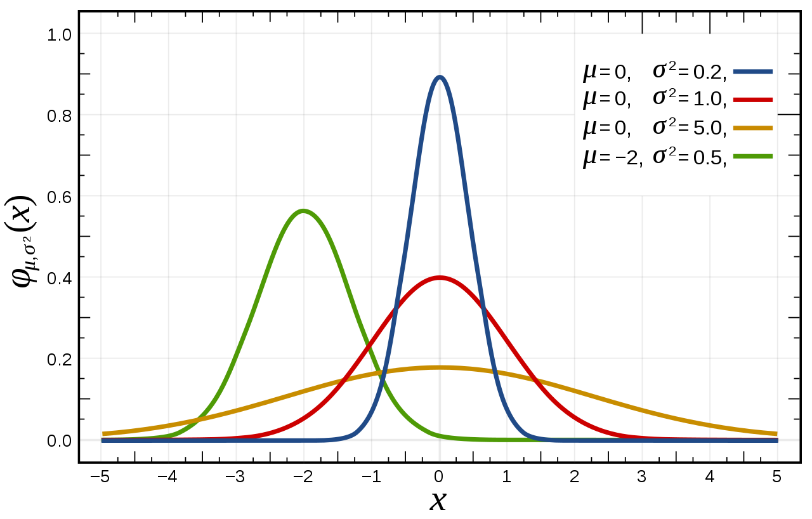

Normal Distribution

Slide 12
Q - Q Plots!

Slide 13
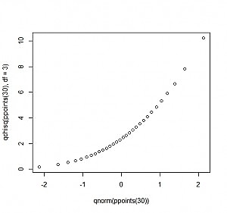
Quantile-Quantile Plot
A scatterplot created by plotting two sets of quantiles against one another.
Let’s try to check whether the data comes from a normal distribution.
Q-Q plots that look like this usually mean your sample data are skewed.

Slide 14
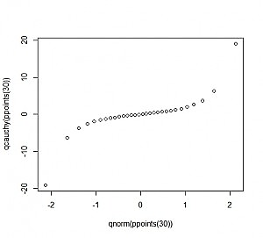
Quantile-Quantile Plot
A scatterplot created by plotting two sets of quantiles against one another.
Let’s try to check whether the data comes from a normal distribution.
Q-Q plots that exhibit this behavior usually mean your data have more extreme values than the data coming from a Normal distribution.

Slide 15
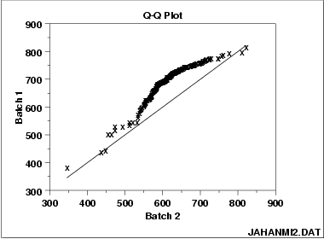
Quantile-Quantile Plot
A scatterplot created by plotting two sets of quantiles against one another.
These 2 batches do not appear to have come from populations with a common distribution.
The batch 1 values are higher than the corresponding batch 2 values.
The differences are increasing from values 525 to 625. Then the values for the 2 batches get closer again.

Slide 16
Benefits of Quantile-Quantile Plot
The sample sizes do not need to be equal.
Many distributional aspects can be simultaneously tested. For example, shifts in location, shifts in scale, changes in symmetry, and the presence of outliers
The q-q plot is used to answer the following questions: Do two data sets come from populations with a common distribution? Do two data sets have common location and scale? Do two data sets have similar distributional shapes? Do two data sets have similar tail behavior?
Details Skipped
http://www.itl.nist.gov/div898/handbook/eda/section3/qqplot.htm

Slide 17
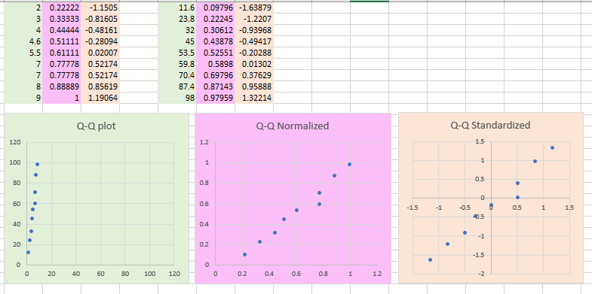
Normalization and Standardization

Slide 18
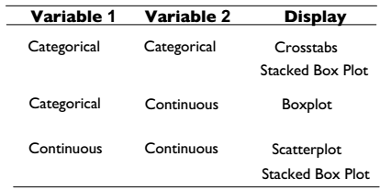
Convention for Bivariate Data

Slide 19
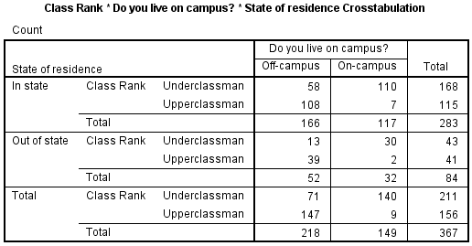
Convention for Bivariate Data

Slide 20
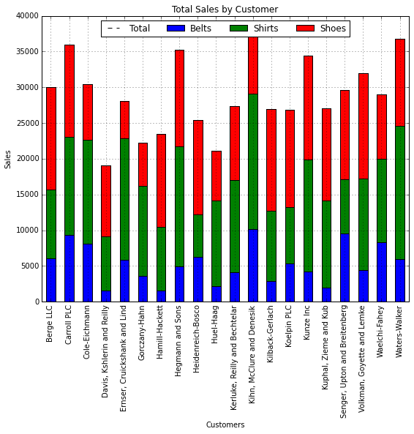
Convention for Bivariate Data

Slide 21
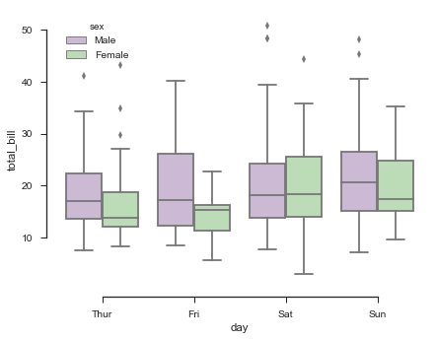
Convention for Bivariate Data

Slide 22
Convention for Bivariate Data
?

Slide 23
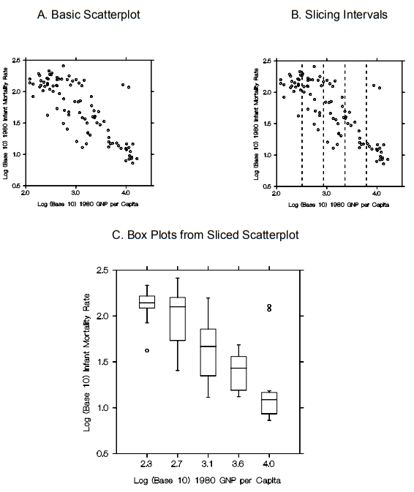
Slicing a Scatterplot
Scatterplots are usually used to examine functional dependence between variables
Visual assessment of functional dependence in “raw” data is problematic
Dividing the plotting region of the scatterplot into a series of vertical “slices” enables visual display of conditional Y distributions

Slide 24
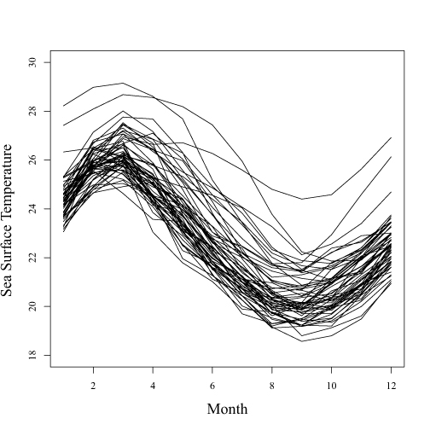
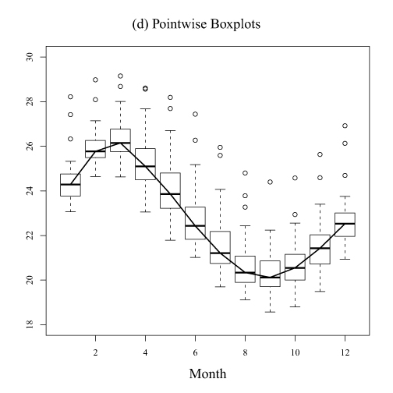
Box Plot
The pointwise boxplots of sea surface temperatures (SST) with medians connected by a black line.
Data of monthly sea surface temperatures Pacific Ocean from 1951 to 2007.
https://en.wikipedia.org/wiki/Functional_boxplot

Slide 25
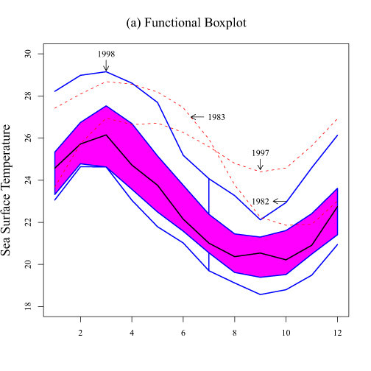
Functional Box Plot
A black curve representing the median curve. The red dashed curves are the outlier candidates detected by the 1.5 times the 50% central region rule.
Data of monthly sea surface temperatures Pacific Ocean from 1951 to 2007.

Slide 26
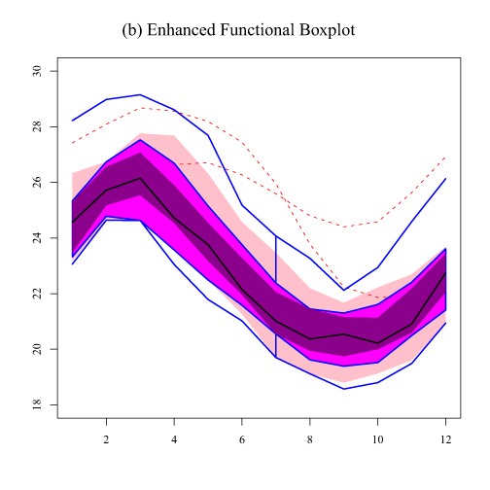
Functional Box Plot
The enhanced functional boxplot of SST with dark magenta denoting the 25% central region, magenta representing the 50% central region and pink indicating the 75% central region.

Slide 27
Yours to Explore
Bagplot: https://en.wikipedia.org/wiki/Bagplot
Candlestick chart: https://en.wikipedia.org/wiki/Candlestick_chart
Kagi Chart: https://en.wikipedia.org/wiki/Kagi_chart
Fan Chart: https://en.wikipedia.org/wiki/Fan_chart_(statistics)
… there are still a lot out there!

Slide 28
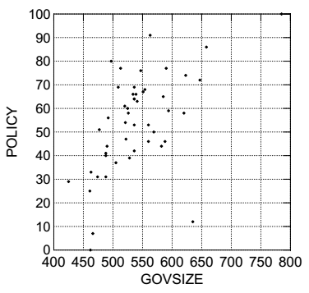
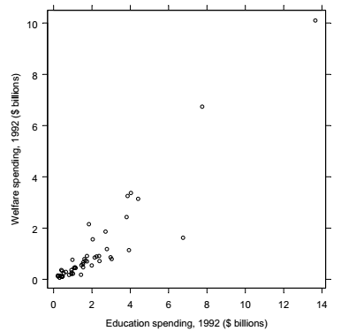
Class Activity
How can you improve the readability of these charts?
Chart 1
Chart 2

Slide 29
Poorly Constructed Scatterplot

Slide 30
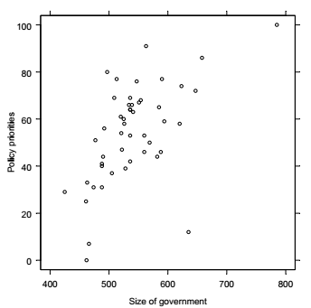
Possible Improvement

Slide 31
Poorly Constructed Scatterplot

Slide 32
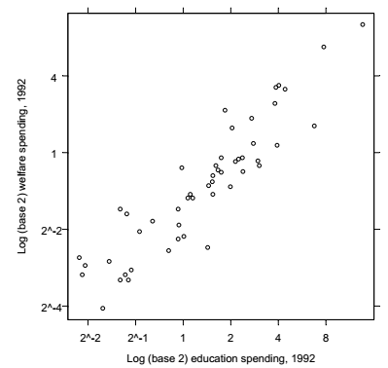
Possible Improvement
Transforming variable values in order to improve visual resolution in a scatterplot

Slide 33
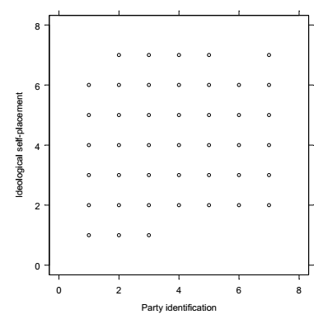
Poorly Constructed Scatterplot

Slide 34
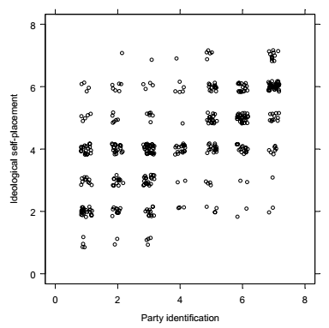
Possible Improvement
Add a little random noise to the data in order to see the cloud more clearly

Slide 35
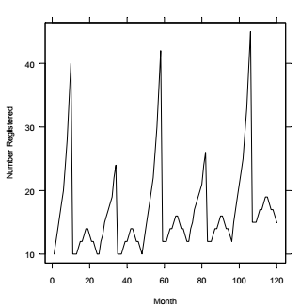
Poorly Constructed Scatterplot

Slide 36
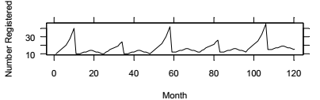
Possible Improvement
Control aspect ratio of the bounding box for better visual perception.

Slide 37
Careful!
Changing the relative lengths of the axes can change how the relationship is perceived.

Slide 38
General Guidelines
Use axes on all four sides to enclose the plotting region
Clear axis labels
Rectangular grid lines within the plotting region are usually unnecessary
Tick marks should point outward, rather than inward and relatively few tick marks should be used on each axis
Data rectangle should be slightly smaller than the scale rectangle.
If necessary, transform data values (alternatively, used transformed scales on coordinate axes) so plotted points fill up as much of the data rectangle as possible

Slide 39
Learning Goals
Learning Basic Statistical Plots
Understanding how to interpret Box-Plots
Evaluating the effectiveness of a chart or describing possible improvements
Given a data set, planning quick plots to get insight from the data
Being able to choose charts that best suit the context

